Slide 1
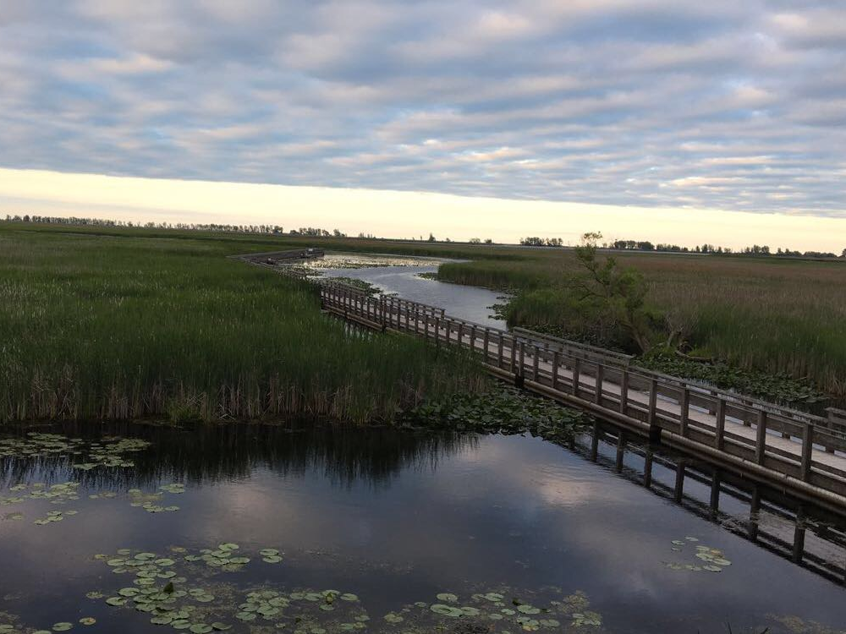
Retreating in mid-career: Addressing the challenges faced by the unhappiest faculty in the academe
David M. Andrews
Judy A.K. Bornais
Notes:
D - 2 min
-introductions and then very brief reasoning for why we did this and why we think it is important
-growing level of discourse on mid-career faculty – nothing done for them, mostly for those starting out
-some unhappy .. Unclear how to connect with changing world, students
-focus on resilience in the literature and popular press
-so much change going on!
-impact as TLCs – a campus-wide initiative
-overall health and wellness of our colleagues

Slide 2
Burnout Inventory
http://www.test-stress.com/en/free-burnout-test.php

Slide 3
Stress Inventory
https://cmha.ca/whats-your-stress-index/
STLHE 2019 - Mid-career retreat
Notes:
J/D – 5 min
-Get them to fill out either the stress or burnout scales independently online
-we could have them up on the screen from the websites
-then share your results with the larger group. How do you feel after getting your scores?

